Slide 1
Money Laundering
MCAS

Slide 2
What is Money Laundering?
Money laundering is a fundamentally simple concept:
It is the process by which proceeds from a criminal activity are disguised to conceal their illicit origins.
Basically, money laundering involves the proceeds of criminal activity: derived property
For Example: You rob a bank → The money you steal is a result of the crime

Slide 3


Slide 4
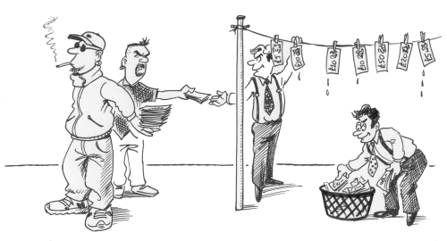
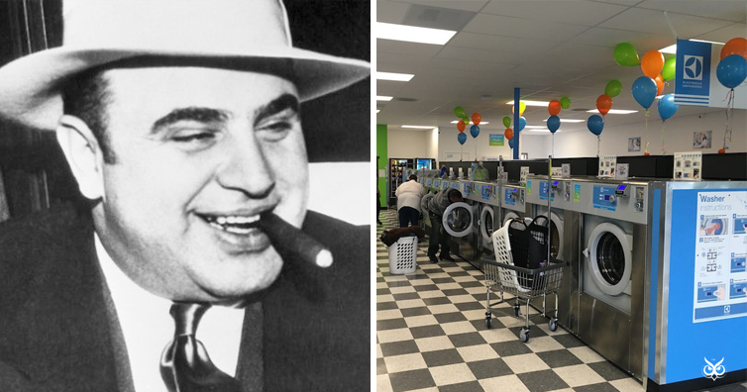
Money Laundering???

Slide 5
Money Laundering
Definition of Money Laundering:
The conversion or transfer of property, knowing that such property is derived from [criminal activity]. . . for the purpose of concealing or disguising the illicit origin of the property or of assisting any person who is involved in the commission of such an offense . . . to evade the legal consequences of his actions;
The concealment or disguise of the true nature, source, location, disposition, movement, rights with respect to, or ownership of property, knowing that such property is derived from an offense or from an act of participation in such an offense.
United Nations Convention Against Illicit Traffic in Narcotic Drugs and Psychotropic Substances (1988)

Slide 6
Money Laundering
In other words, Money Laundering has two parts:
The “Predicate Crime”
This is the actual criminal activity. General the range of predicate offenses is very wide.
The transfer/concealment of ill-gotten proceeds
The act of money laundering itself. This is treated as a separate crime.

Slide 7
Money Laundering – The process
ML is generally categorized as a three stage process:
Placement
Layering
Integration

Slide 8
Money Laundering - Placement
The initial stage of the process involves placement of illegally derived funds into the financial system, usually through a financial institution.

Slide 9

Placement Examples
Bulk cash smuggling involves literally smuggling cash into another country for deposit into offshore banks or other type of financial institutions that honor client secrecy.
Structuring, also referred to as “smurfing,” is a method in which cash is broken down into smaller amount, which are then used to purchase money orders or other instruments to avoid detection or suspicion.
Cash-intensive business occurs when a business that legitimately deals with large amounts of cash uses its accounts to deposit money obtained from both everyday business proceeds and money obtained through illegal means (Called “Co-Mingling”). Businesses able to claim all of these proceeds as legitimate income
Bank capture refers to the use of a bank owned by money launderers or criminals, who then move funds through the bank without fear of investigation.
Real estate laundering occurs when someone purchases real estate with money obtained illegally, then sells the property. This makes it seem as if the profits are legitimate.
Casino laundering involves an individual going into a casino with illegally obtained money. The individual purchases chips with the cash, plays for a while, then cashes out the chips, and claims the money as gambling winnings.

Slide 10
Money Laundering - Layering
The second money laundering stage occurs after the ill-gotten gains have entered the financial system, at which point the funds, security or insurance contract are converted or moved to other institutions further separating them from their criminal source.
Placed funds be used to purchase other securities, insurance contracts or other easily transferable investment instruments and then sold through yet another institution.
The funds could also be transferred by any form of negotiable instrument such as check, money order or bearer bond, or transferred electronically to other accounts in various jurisdictions.
The launderer may also disguise the transfer as a payment for goods or services or transfer the funds to a shell corporation.

Slide 11
Money Laundering - Integration
The third stage involves the integration of funds into the legitimate economy. This is accomplished through the purchase of assets: such as real estate, securities or other financial assets, or luxury goods.
The money appears to have a “legitimate”, or at least unknowable, origin.

Slide 13
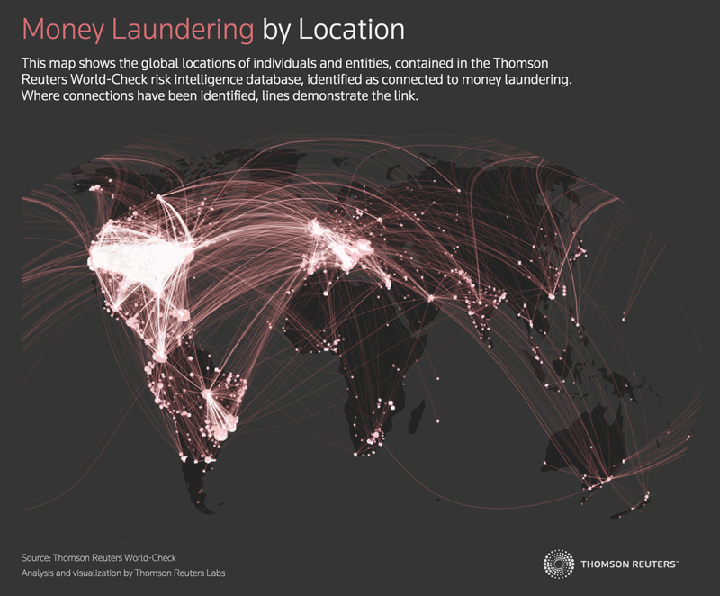

Slide 14
ML Statistics
Global money laundering transactions are estimated at 2 to 5% of global GDP, or roughly U.S. $1-2 trillion annually (1-2,000 조원)

Slide 15
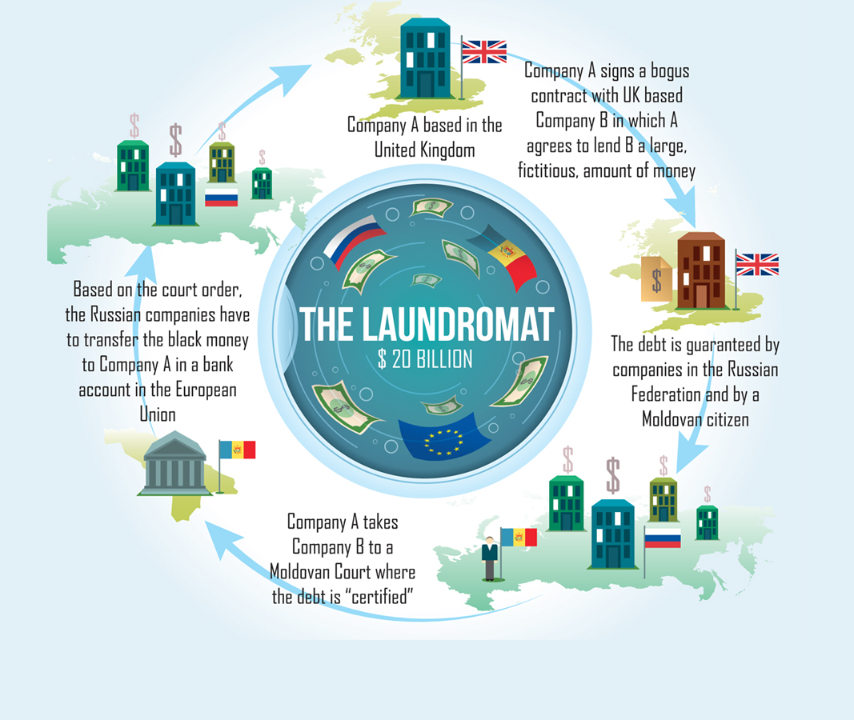

Slide 16
